Slide 1
Lecture 1
Introduction and Setting up a Python Environment

Slide 2
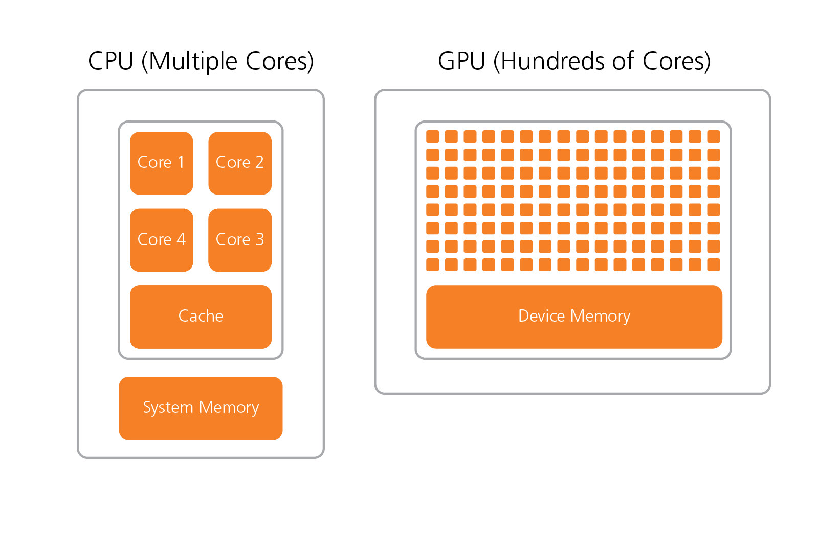
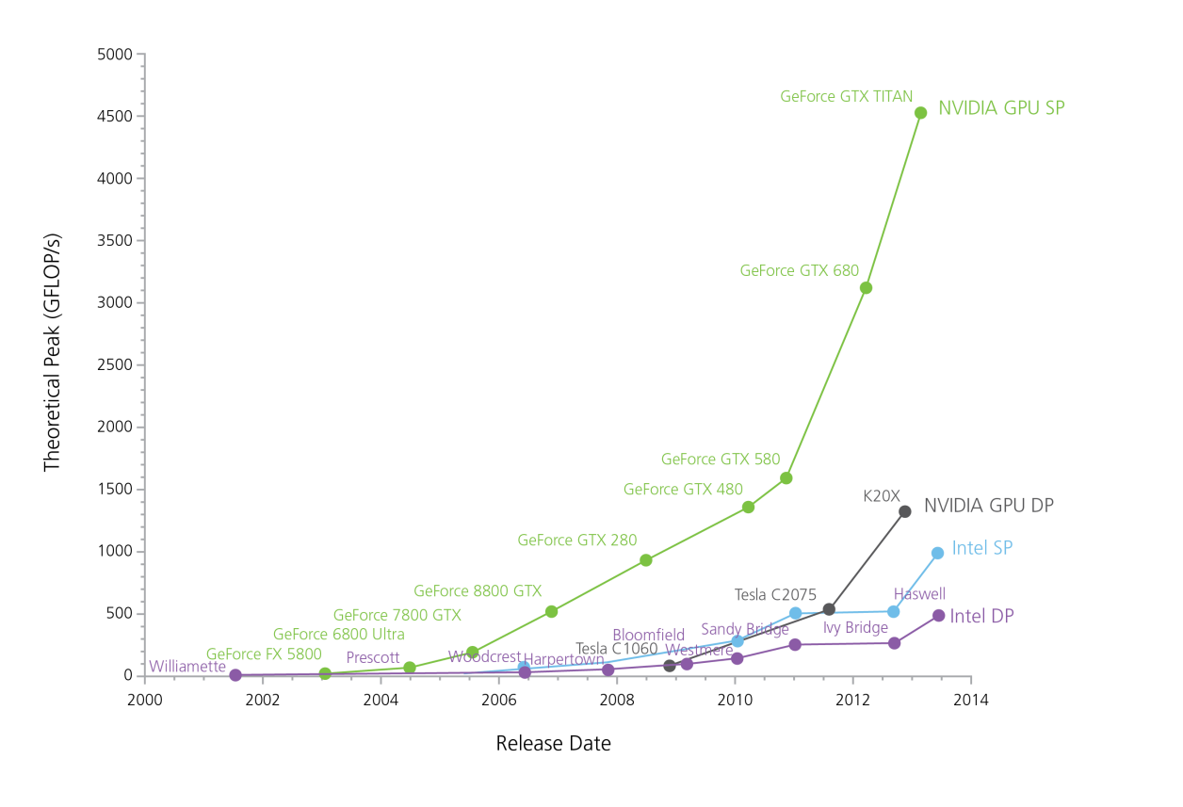
Recent changes
Parallelism
https://michaelgalloy.com/2013/06/11/cpu-vs-gpu-performance.html
https://kr.mathworks.com/company/newsletters/articles/gpu-programming-in-matlab.html

Slide 3
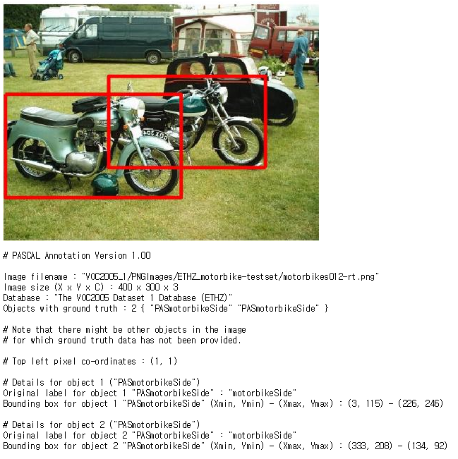
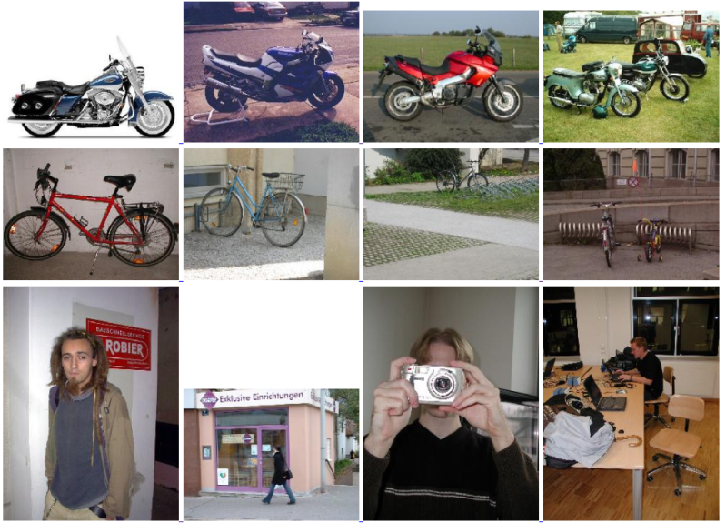
Recent changes
Data
The PASCAL VOC(2005)
1578 images, 4 classes(2005)
bicycles, cars, motorbikes, people
http://host.robots.ox.ac.uk/pascal/VOC/

Slide 4
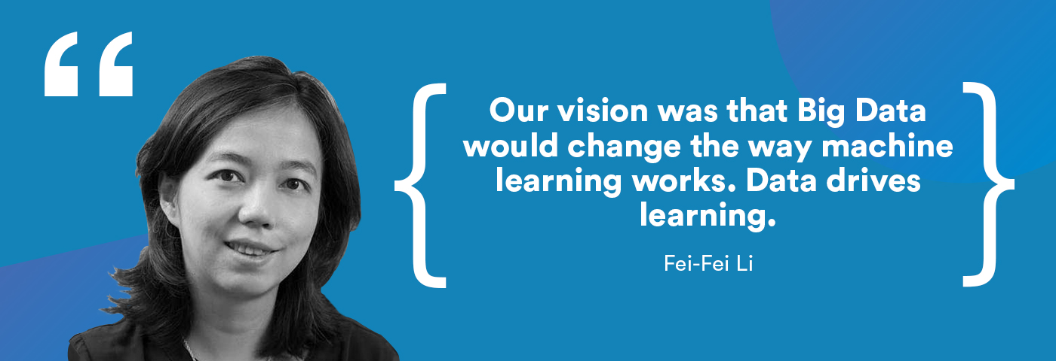
Recent changes
Data
ImageNet (2009)
14,197,122 images, 21841 synsets
http://image-net.org

Slide 5
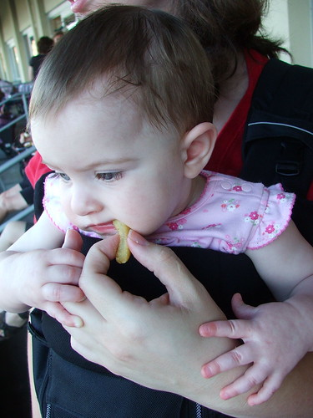
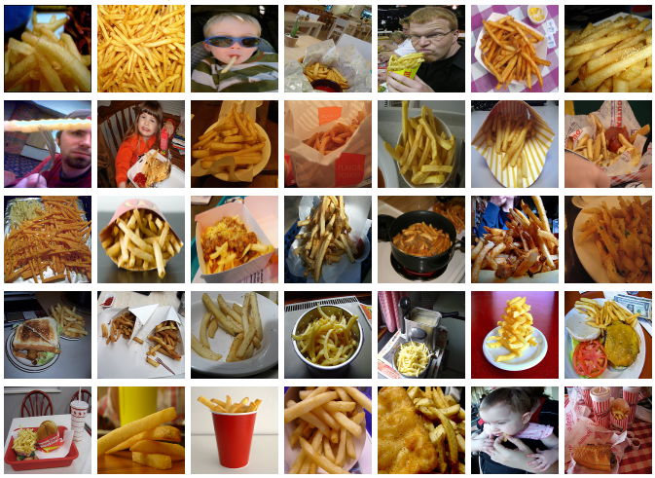
Recent changes
Data
ImageNet Large Scale Visual Recognition Challenge(ILSVRC)
http://image-net.org/challenges/LSVRC/2010/browse-synsets

Slide 6
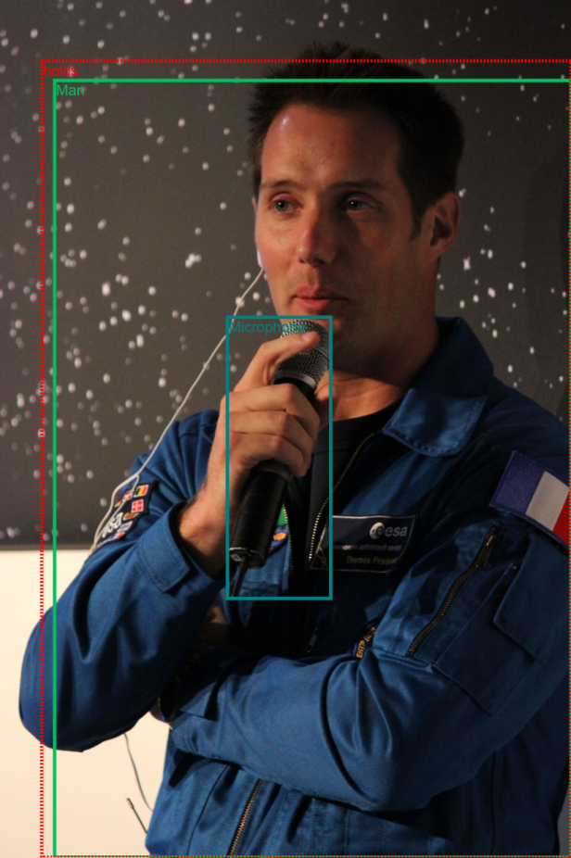
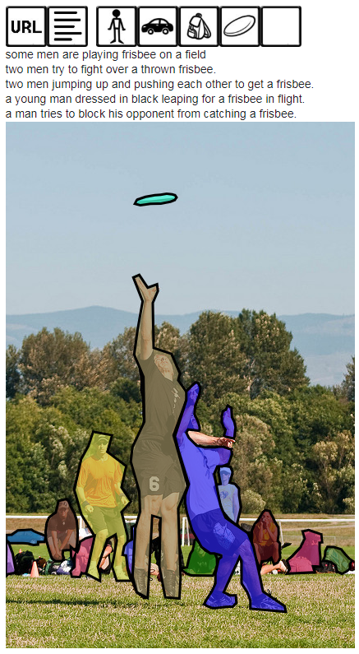
Recent changes
Data
COCO(MS)
http://cocodataset.org/#home
Open Images Dataset(Google)
https://storage.googleapis.com/openimages/web/index.html

Slide 7
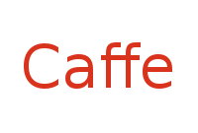


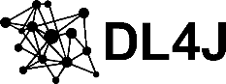








Recent changes
Deep-learning software
2010
2013
2014
2015
2016
2017
https://www.slideshare.net/JunyiSong1/ss-75552936
https://github.com/fastai/fastai/releases?after=test-1.0.5
https://github.com/pytorch/pytorch/releases?after=v0.1.3

Slide 8
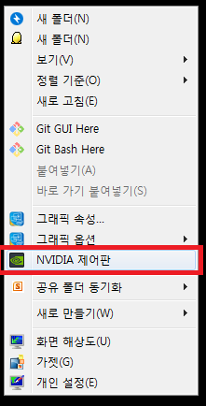
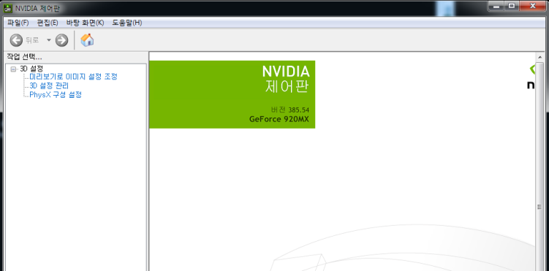
Do I have a CUDA-enabled GPU?
CUDA
A parallel computing platform and application programming interface model create by Nvidia.
It allows software developers and software engineers to use a CUDA-enabled GPU for general purpose processing.
https://en.wikipedia.org/wiki/CUDA
Do I have a CUDA-enabled GPU?
Right-click on desktop
https://developer.nvidia.com/cuda-gpus

Slide 9
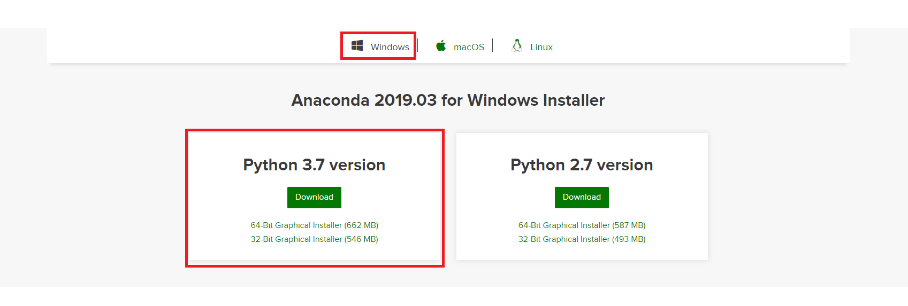
Setup a Python Environment for ML
Install Anaconda(or Miniconda)
Anaconda
Manage libraries, dependencies, and environments with Conda
https://www.anaconda.com/distribution/
https://docs.conda.io/en/latest/miniconda.html

Slide 10
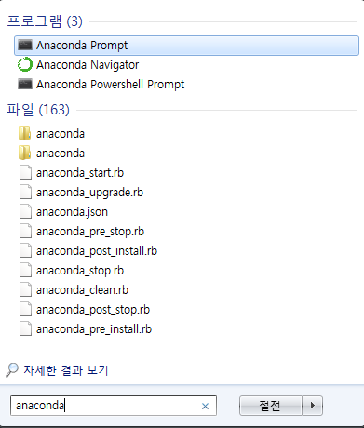
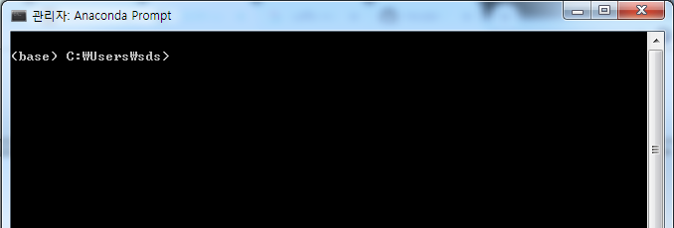
Setup a Python Environment for ML
Install Anaconda(or Miniconda)
Anaconda
start -> anaconda prompt

Slide 11
Setup a Python Environment for ML
Conda tutorial
Managing Conda
Verify that conda is installed and running on your system by typing:
conda --version
Update conda to the current version. Type the following:
conda update conda
If a newer version of conda is available, type y to update.

Slide 12
Setup a Python Environment for ML
Conda tutorial
Managing Environment
Create a new environment:
conda create --name test_env
Create a new environment and install a package in it:
conda create --name test_env numpy
To use, or "activate" the new environment, type the following:
conda activate test_env
To see a list of all your environments, type:
conda info --envs
conda env list
Change your current environment back to the default (base):
conda activate
To remove environment “test_env”, type:
conda env remove --name test_env

Slide 13
Setup a Python Environment for ML
Conda tutorial
Managing Python
Create a new environment named “test_env” that contains Python 3.5
conda create --name test_env python=3.5
To use the new environment, type the following:
conda activate test_env
Verify which version of Python is in your current environment:
python --version
Interacting with python interpreter:
python
Hello World!
print(“Hello World!”)
You can quit from the interpreter:
quit()

Slide 14
Setup a Python Environment for ML
Conda tutorial
Managing Packages
Check to see if a package you have not installed named “numpy" is available from the Anaconda repository:
conda search numpy
Install this package into the current environment:
conda install numpy
Check to see if the newly installed program is in this environment:
conda list
Managing Packages (pip)
You can use pip instead of conda:
pip install numpy, pip install numpy==1.16.3, pip list

Slide 15
Setup a Python Environment for ML
Comparison of Deep-learning Software
Comparison of Deep-learning Software
https://en.wikipedia.org/wiki/Comparison_of_deep-learning_software

Slide 16
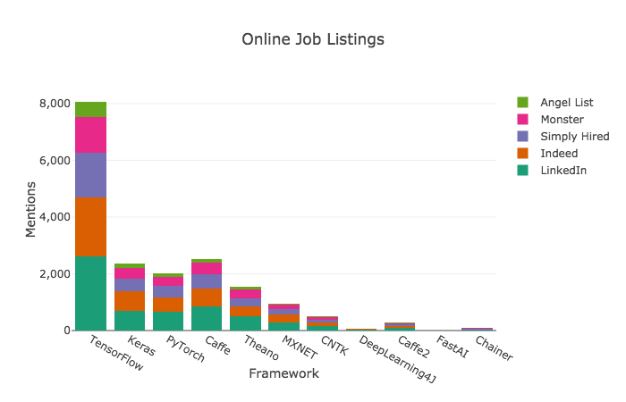
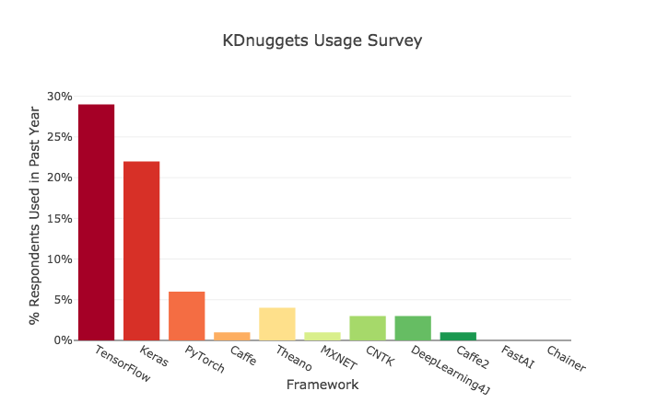
Setup a Python Environment for ML
Comparison of Deep-learning Software
Comparison of Deep-learning Software
https://towardsdatascience.com/deep-learning-framework-power-scores-2018-23607ddf297a

Slide 17
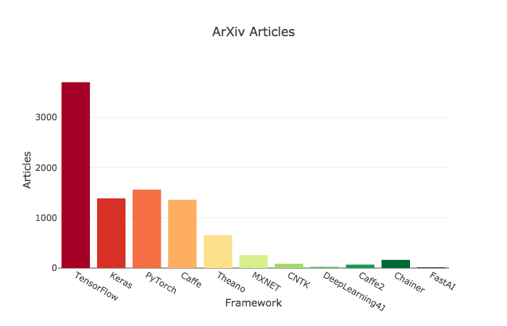
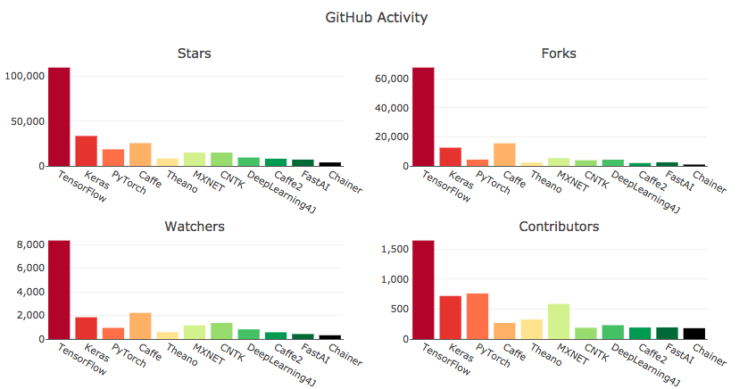
Setup a Python Environment for ML
Comparison of Deep-learning Software
Comparison of Deep-learning Software
https://towardsdatascience.com/deep-learning-framework-power-scores-2018-23607ddf297a

Slide 18
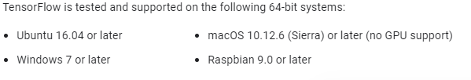
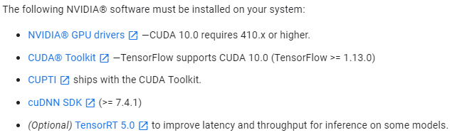
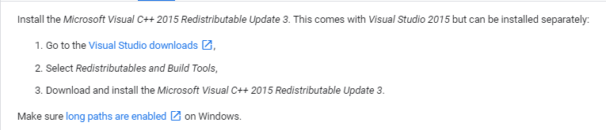
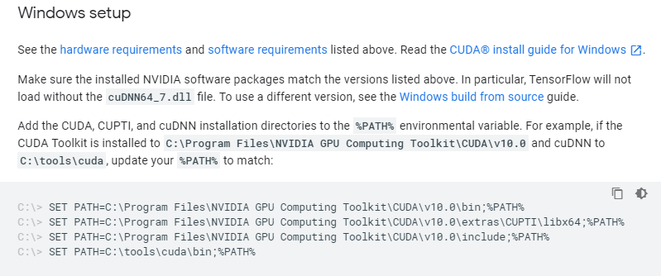
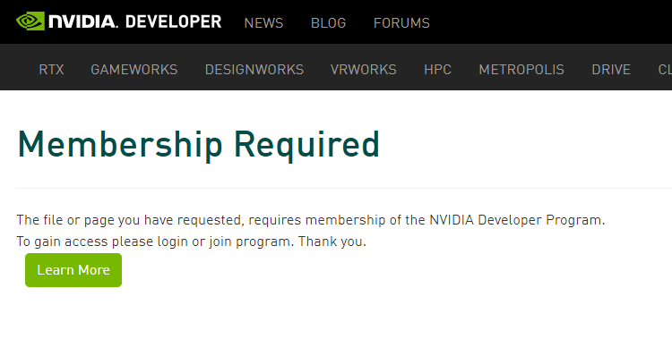
Setup a Python Environment for ML
Install Tensorflow
Tensorflow install page - https://www.tensorflow.org/install

Slide 19
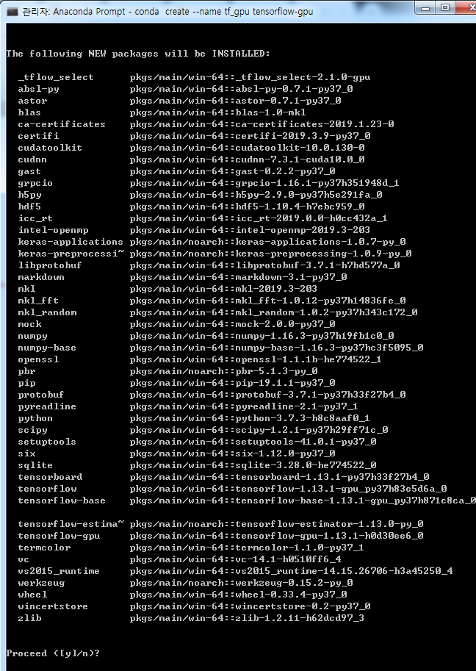
Setup a Python Environment for ML
Install Tensorflow
conda create --name tf_gpu tensorflow-gpu
https://github.com/fo40225/tensorflow-windows-wheel

Slide 20
Setup a Python Environment for ML
Install Tensorflow
Verify that tensorflow-gpu is properly installed.
activate the environment:
conda activate tf_gpu
run python:
python
Verify that tensorflow-gpu is propely installed:
import tensorflow as tf
tf.__version__
Verify that tensorflow can use my gpu:
from tensorflow.python.client import device_lib
device_lib.list_local_devices()

Slide 21
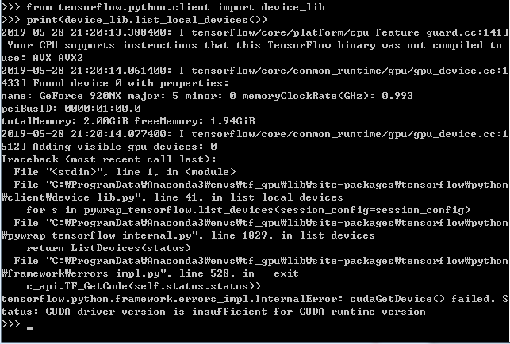
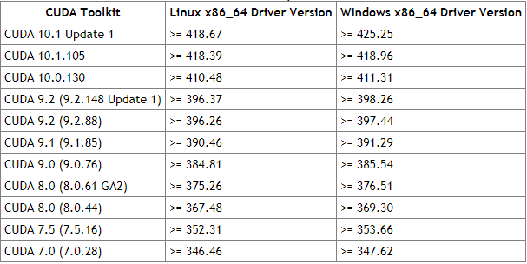
Setup a Python Environment for ML
Install Tensorflow
ERROR) CUDA driver version is insufficient for CUDA runtime version!
CUDA toolkit release note:
https://docs.nvidia.com/cuda/cuda-toolkit-release-notes/

Slide 22
Setup a Python Environment for ML
Install Tensorflow
ERROR) CUDA driver version is insufficient for CUDA runtime version!
How do I know if I have the latest drivers?
www.nvidia.com/drivers
or install tensorflow-gpu=1.10.0 with cuda 9.0
conda create –name tf_gpu_1_10 tensorflow-gpu=1.10.0

Slide 23
Exercise
Try to do the followings:
Recent changes
Visit ImageNet LSVRC 2010 browse-synsets page
There is a synset, Japanese maple. What is synonyms of Japanese maple?
How many pictures are there?
How old is Tensorflow?
Python Environment
Do your system has a CUDA-enabled GPU?
What is the version of Nvidia’s driver?
Create a python environment containing an appropriate version of tensorflow-gpu and jupyter
Create a conda environment containing an appropriate version of tensorflow-gpu and jupyter
What is the version of cudatoolkits installed?
Verify that gpu is available.

Slide 24
Jupyter Notebook
Activate an environment containing jupyter
Create a folder named ‘my_workspace’:
mkdir my_workspace
Change directory to my_workspace by:
cd my_workspace
Run jupyter notebook by typing:
jupyter notebook

